Slide 1

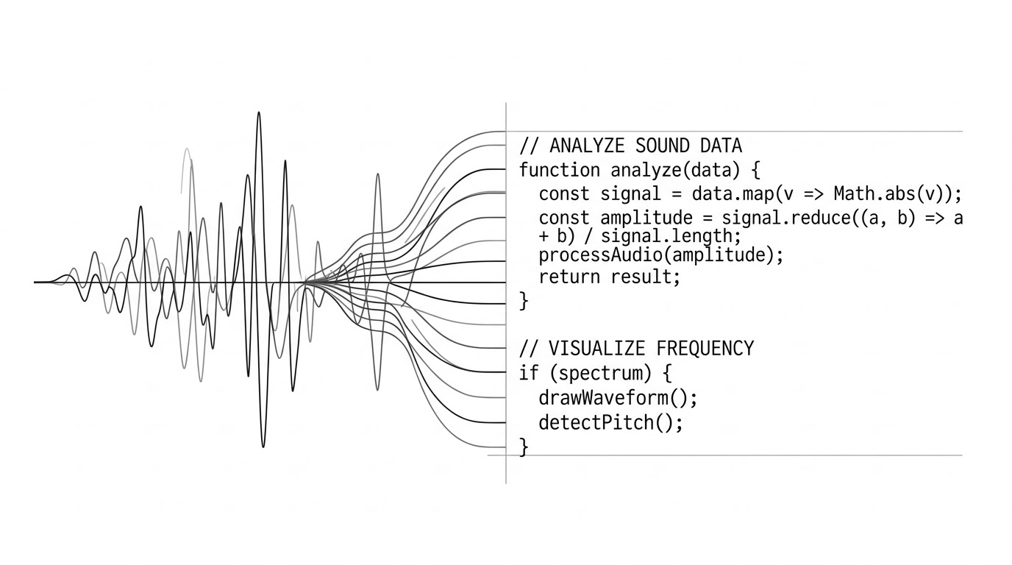
Intelligent Meeting notes
Core Objective
Design a browser-native extension and backend system to capture, stream, and summarize multi-source meeting audio using Google Gemini LLMs.
Meeting Companion AI
Design, Architecture, and Implementation of an Automated Meeting Notes Engine

Slide 2

PROJECT ARCHITECTURE & SCOPE
Project Scope & Technical Constraints
01 // FUNCTIONAL REQUIREMENTS
02 // TECHNICAL CONSTRAINTS
Dual-stream audio recording of both browser meeting audio and physical user microphone.
Automated note compilation featuring an Executive Summary, Discussion Points, Decisions, and Action Items.
Memory efficiency to avoid browser memory leakage during long recordings.
Manifest V3 compliance navigating background service worker limitations without direct DOM or audio hardware access.
Hardware agnosticism automatically adjusting to client microphone configurations of 44.1kHz or 48kHz.
SYSTEM SCHEMATIC // ENGINE
Optimized background capture loop featuring automatic sample rate alignment.
CONFIG: 44.1kHz / 48kHz AUTO

Slide 3
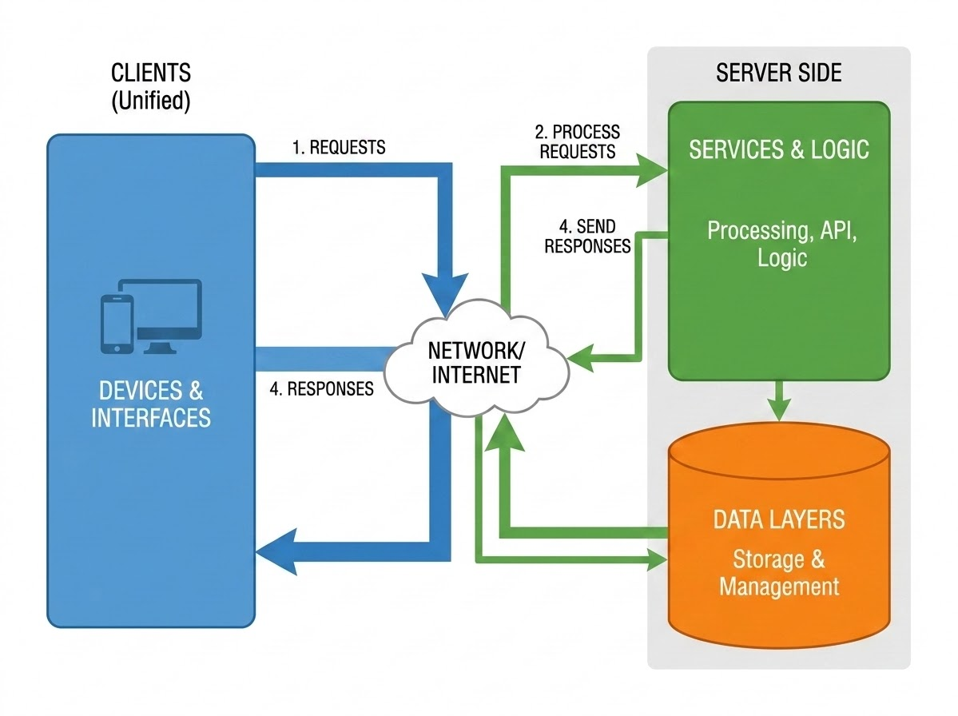
System Architecture & Data Flow
A clean client-to-server data architecture pipeline.
PIPELINE OVERVIEW
A decoupled, low-latency pipeline connecting client-side Web Audio capture components to FastAPI processing, backed by ephemeral AI summaries.
01 // CLIENT EXTENSION
02 // FASTAPI BACKEND
03 // AI LAYER
• Popup UI for control
• Background Worker orchestration
• Offscreen Web Audio API context
PCM Stream
• Service hosted on AWS EC2
• REST endpoints for session mgmt
• Raw PCM chunking & note gen
Audio API
• Google Gemini API utilization
• Ephemeral Gemini File Storage
• Structured summary generation

Slide 4
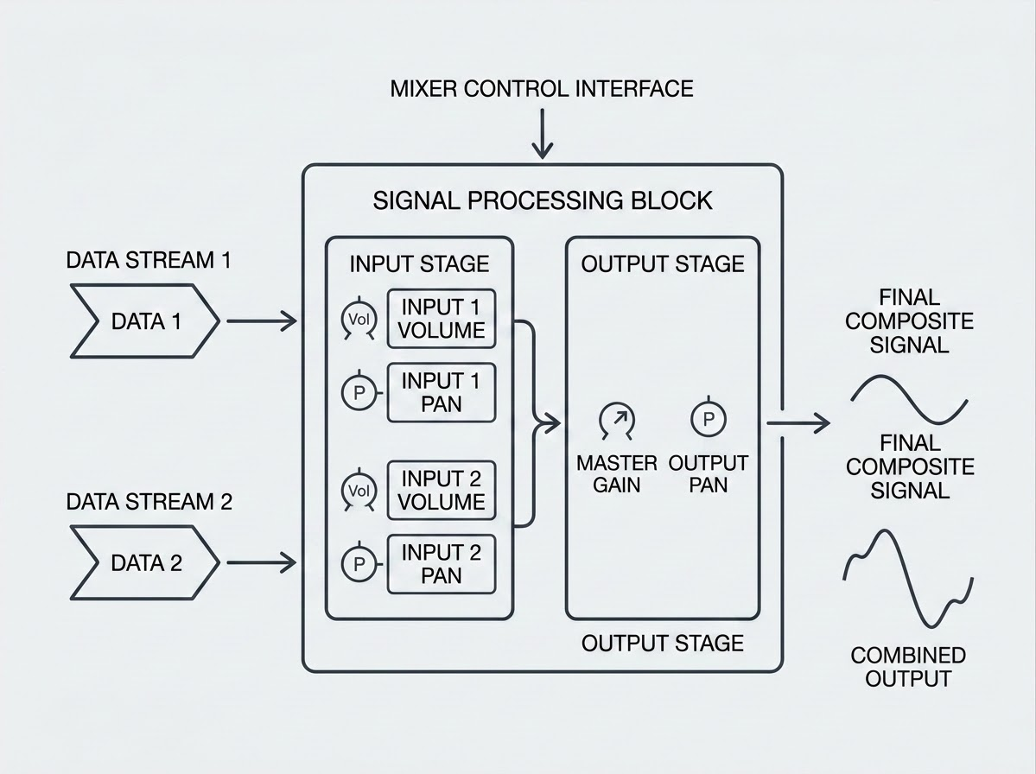
SYSTEM ARCHITECTURE & DATA INGESTION
Audio Mixing & Streaming Pipeline
01 / CAPTURE
02 / ENCODE
03 / STREAM
Dual-Source Mixing
PCM Conversion
3s Buffered Chunking
Uses tabCapture to grab browser audio.
Merges it with the local mic stream via AudioContext.
Performs real-time Float32 to Int16 conversion.
Translates native Web Audio into 16-bit Signed PCM integers.
Accumulates PCM buffers locally to maintain a flat memory footprint.
Posts 3-second binary octet-streams to the server chunk endpoint.
FIG 01: DUAL-SOURCE SIGNAL SUMMING & MIXING SCHEMA

Slide 5

WAV Reconstruction & Gemini Notes Engine
SYS_COMPILE_01
HEADER_PREPEND_02
API_HANDSHAKE_03
01. Chunk Assembly
The server appends incoming chunks directly to disk for dynamic WAV assembly.
02. Prepend Header
Upon completion, it prepends a dynamic 44-byte WAV header matching the client hardware sample rate.
03. File Upload
The fully compiled WAV file is uploaded to the Gemini File Manager for preprocessing.
ASSET_PURGE_05
FALLBACK_QUEUE_04
05. Storage Cleanup
Automatic storage cleanup purges the temporary WAV file from Google Cloud immediately after notes are generated to protect data privacy.
04. Fallback Queue
The system implements a multi-model fallback queue, retrying across gemini-2.5-flash and gemini-2.0-flash for high availability.

Slide 6


[ DEPLOYMENT_LOG // REF: ENG-CH-03 ]
Ø 64MM
Key Engineering Challenges & Solutions
[ CHALLENGE 01 // POPUP ]
[ CHALLENGE 02 // ISOLATION ]
[ CHALLENGE 03 // DRIFT ]
Hardware Prompts Blocked
Chrome blocking hardware prompt popups.
Offscreen API Isolation
Documents lacked local storage access.
Gunicorn Session Drift
Drift causing 404 errors.
RESOLUTION
RESOLUTION
RESOLUTION
[ RESOLUTION 01 // FIX ]
[ RESOLUTION 02 // FIX ]
[ RESOLUTION 03 // FIX ]
Secure Tab Redirection
Implementing a tab redirection to request permission in a secure window context.
Asynchronous Message Proxy
Building an asynchronous message-passing proxy through the background worker.
Worker & Watcher Tuning
Deploying Gunicorn with a single-worker configuration and excluding uploads from directory watchers.
Blueprint Scale Reference // 1:12 Model

Slide 7





Security Controls & Best Practices
Architectural system constraints and secure data compliance standards
01 // SECURE ORIGINS
02 // MANIFEST PERMISSIONS
The architecture enforces secure origins, restraining microphone capture and endpoint requests strictly to secure HTTPS contexts.
Manifest permissions are tightly scoped, limiting host access specifically to the backend API origin.
03 // STRICT CORS
04 // DATA EPHEMERALITY
The FastAPI server configures strict Cross-Origin Resource Sharing to restrict external API requests.
Furthermore, the system guarantees data ephemerality; audio chunks and WAV files are temporarily stored and immediately cleaned up post-processing to ensure maximum security.
SYS_LOCK // SECURE

Slide 8


Key Learnings & Future Roadmap
Technical Milestone Log
SYSTEM ARCHITECTURE & SCALING
01 / INTERNSHIP KEY LEARNINGS
02 / FUTURE ROADMAP & SCALING
Chrome Extension Architecture: Mastered advanced design principles and Manifest V3 life-cycles for robust, background-service-based client execution.
Signal & Audio Processing: Executed Web Audio API graph manipulation and raw PCM signal processing directly within client environments.
Backend Deployment: Developed and deployed scalable ASGI servers leveraging Gunicorn and FastAPI architectures.
AudioWorklet Migration: Shift intensive PCM signal processing off the main UI thread onto dedicated audio threads to guarantee lag-free client performance.
SQLite Database Persistence: Replace volatile in-memory state with a structured relational database layer, enabling seamless multi-worker server clustering and high-availability scaling.
Completed Achievements
Future Upgrades
01 / EXTENSION
Manifest V3
Advanced client service-worker life-cycles
02 / AUDIO API
PCM Processing
Node graph & signal manipulation
03 / ASGI DEPLOY
FastAPI & Gunicorn
High-performance asynchronous backends
04 / MULTI-THREAD
AudioWorklet
Offload signal processing from UI threads
05 / CLUSTER DB
SQLite Persistence
Replace in-memory state to scale multi-worker servers

